Slide 1
Factors Influencing Customer Subscription to Bank Term Deposit Service:
Data Analysis Approach

Slide 2
TASK 1
Prediction Model

Slide 3
Details
01
Data Understanding:
We examined the datasets MarketingCampaignsData.csv and ExistingCustomers.csv, identifying key variables related to demographic information, account details, and marketing campaign data.
02
Data Pre-processing
Includes handling missing values, data cleaning and data preperation
03
Training Model
Splitting the data to train and test and using different algorothms to train data
04
Predictions
Predicting the dependent variables of unseen data.

Slide 4
Data Understanding
.
Missing values and outliers were addressed using appropriate techniques to ensure data integrity and reliability.

Slide 5
Data Preprocessing
Feature engineering techniques, including one-hot encoding and ordinal encoding, were applied to convert categorical variables into numerical representations. Additionally, numerical variables were standardized to achieve consistency in scale.

Slide 6
Logistic regression, random forest, and gradient boosting models were selected due to their suitability for binary classification tasks and ability to handle the dataset's characteristics.
Model Selection

Slide 7
Model evaluation and cross validation
The dataset was divided into training (70%) and testing (30%) sets to evaluate model performance accurately. The chosen models were trained on the training dataset, with logistic regression employing the appropriate algorithm and decision trees/random forest and gradient boosting being built accordingly. Cross-validation with 10 folds was performed to estimate the models' generalization performance.

Slide 8
Evaluation matrix
Model AUC CA F1 Precision Recall MCC
Logistic Regression 0.8920 .8100 .8390 .9030 .8100 .455
Gradient Boosting 0.8820 .9100 .8980. .8970 .9100 .464
Random Forest 0.9920 .9520 .9470 .9530 .9520 .737

Slide 9
Model Selection and predictions
The models were compared based on evaluation metrics, leading to the selection of logistic regression as the optimal model due to its superior performance on the test dataset. The final trained model was utilized to predict the likelihood of customer subscription for the bank's existing clients in the ExistingCustomers.csv dataset based on their attributes.

Slide 10
TASK 2
Clustering

Slide 11
Clustering techniques
The clustering analysis employed the K-means algorithm, an unsupervised learning technique widely used for clustering tasks. The resulting clusters are labelled as C1, C2, and C3.

Slide 12

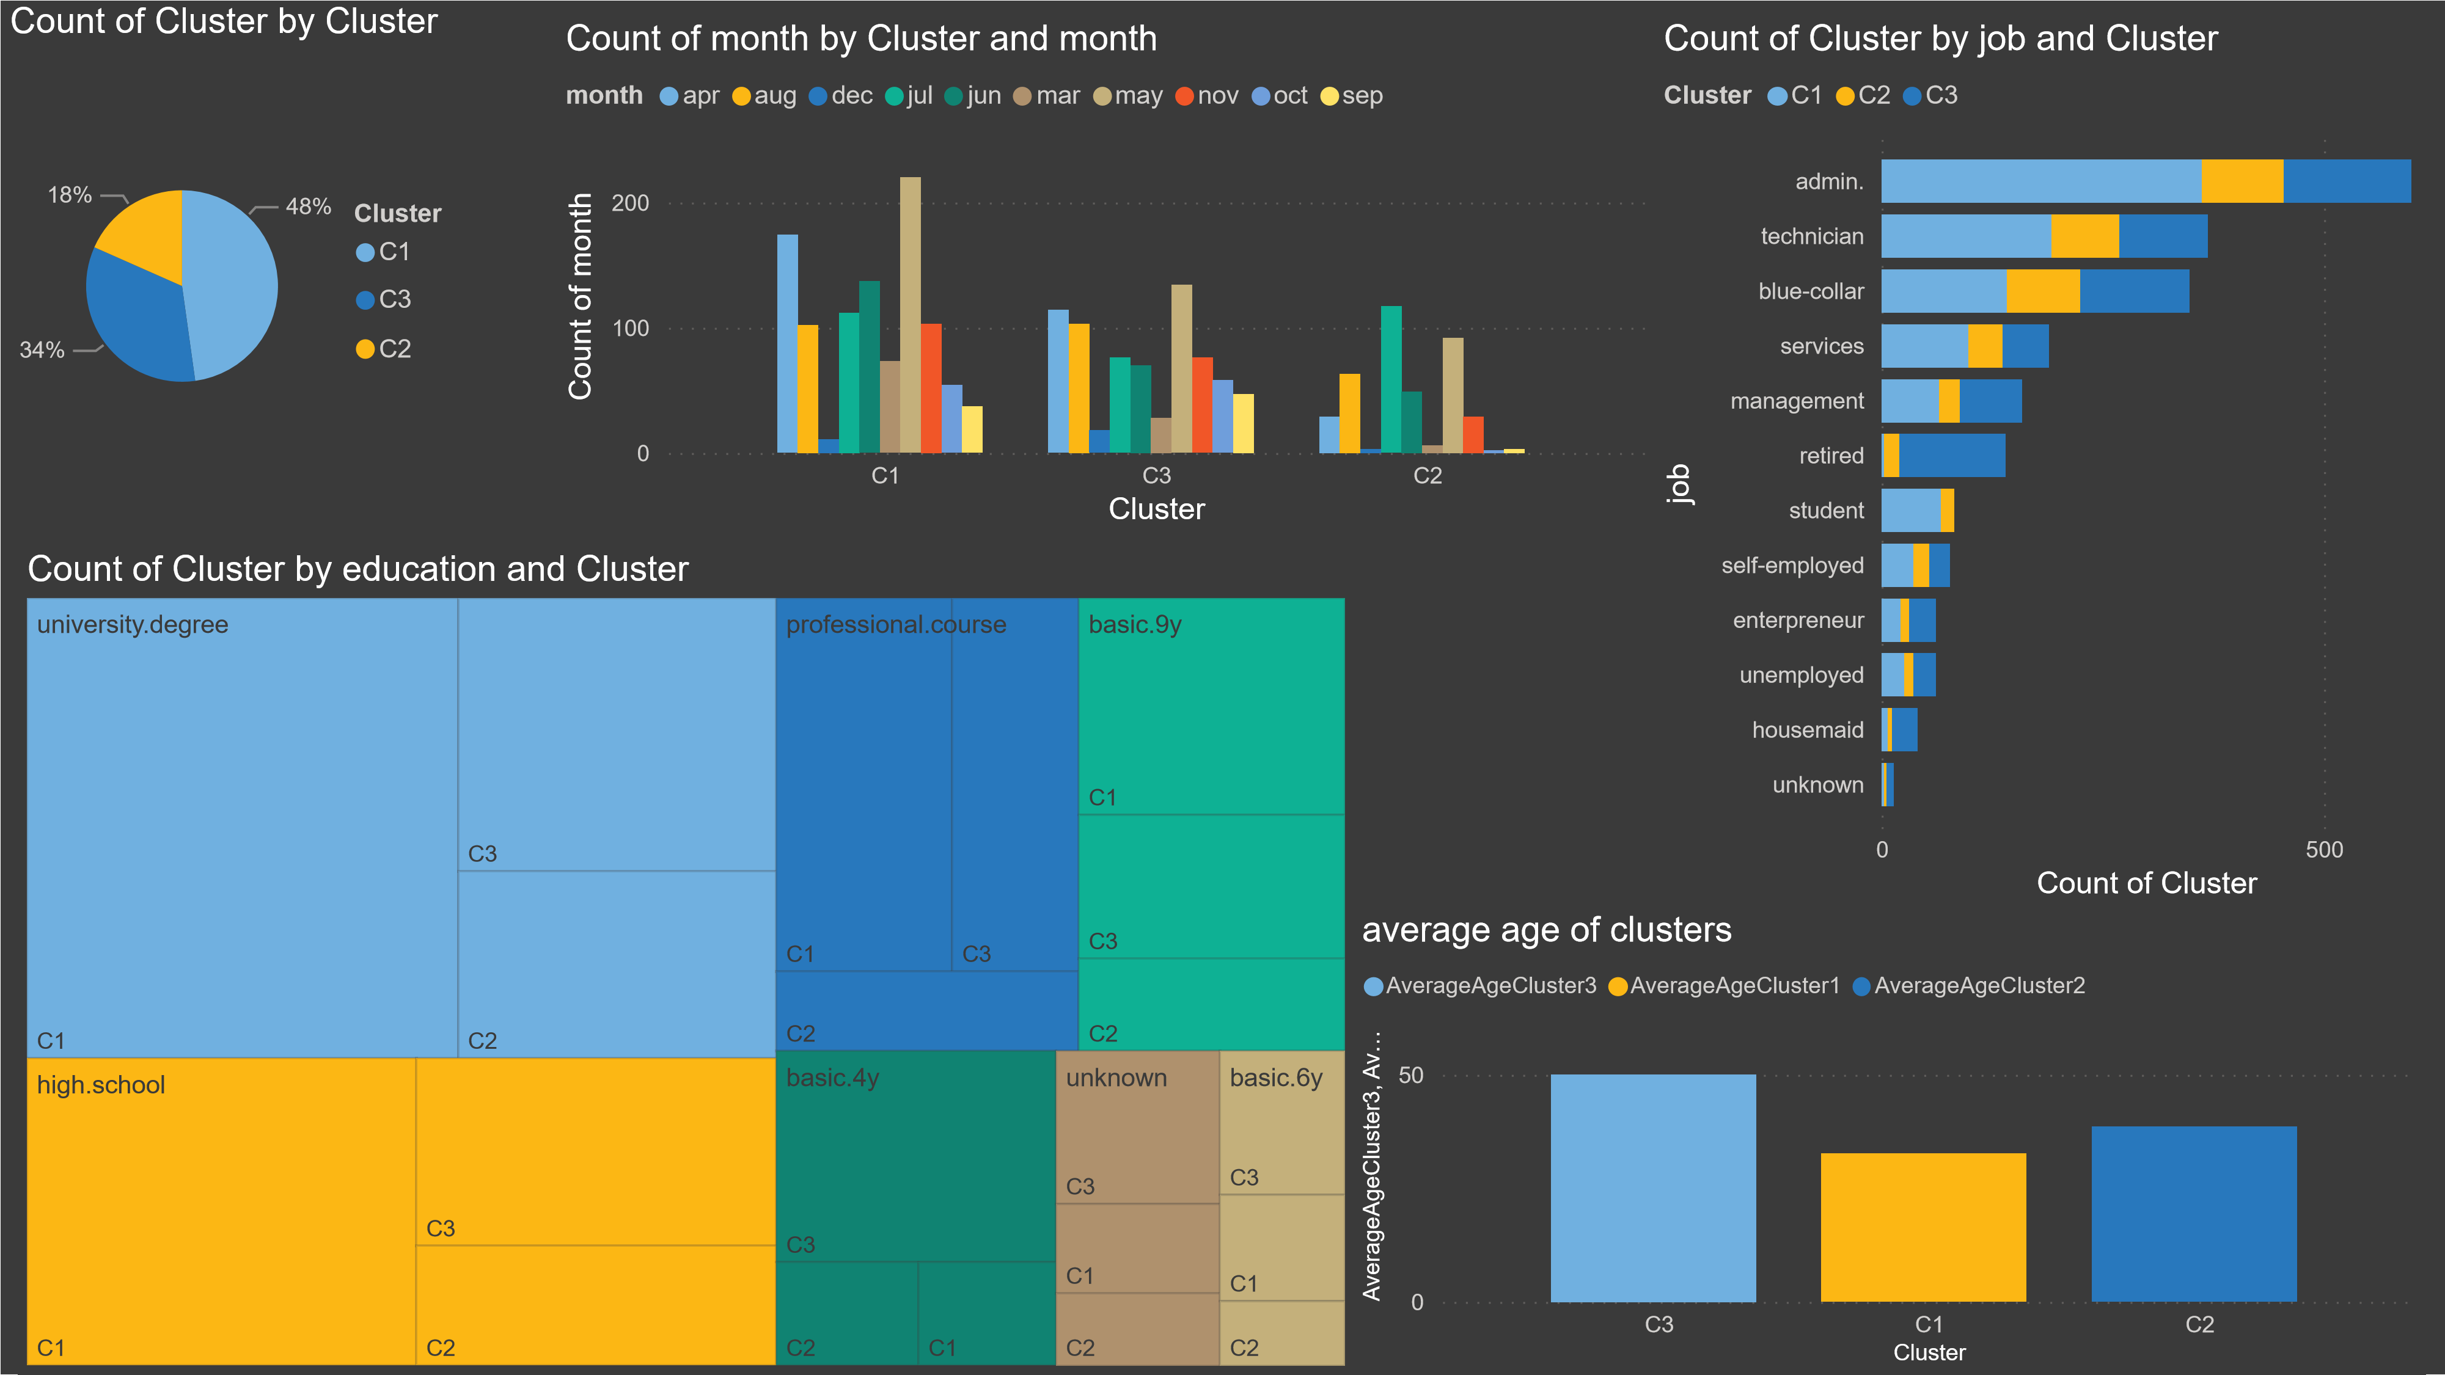
Graphical insights

Slide 13
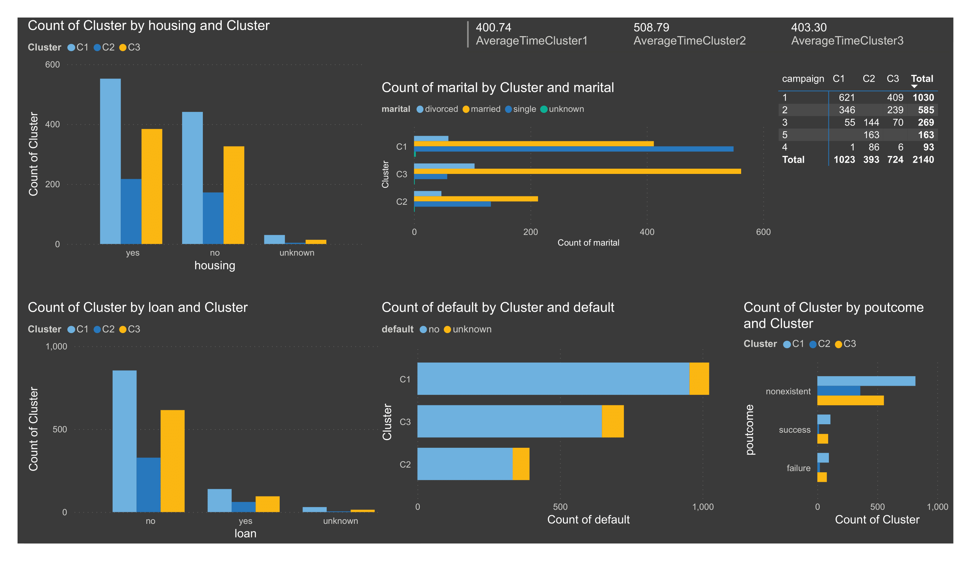
Graphical insights

Slide 15
Conclusion
The clustering analysis of the predicted data using the logistic regression model and the K-means algorithm revealed three distinct clusters. The analysis not only grouped the data effectively but also identified the variables that significantly influence cluster membership. The findings provide valuable insights into the data, enabling informed decision-making based on the distinctive characteristics of each cluster

Slide 16
THANK YOU

